Slide 1
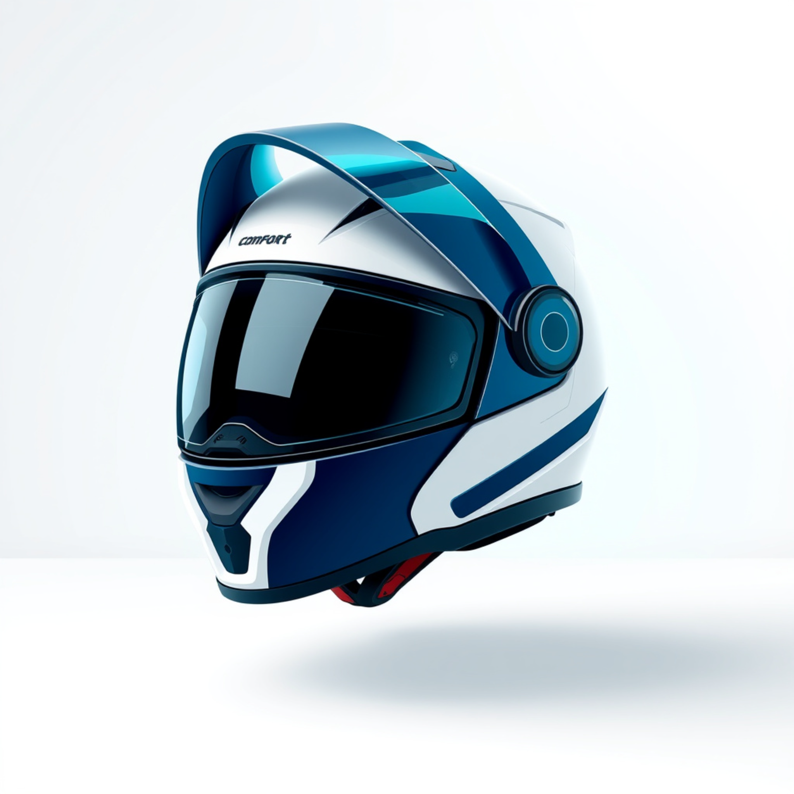




Comfort Helmet
Stay Safe, Stay Cool, Ride Comfortably
Protection that feels lighter, breathes better, and stays ready for the ride.
Protection
Airflow
Comfort

Slide 2


RIDER PAIN POINTS
Problems Faced by Riders
Heat buildup turns a safety essential into something riders want to take off.
Why it matters
When helmets feel hot and sticky, riders are more likely to loosen straps or remove them.
Excessive heat builds up inside the helmet
Sweating becomes constant during long rides
Summer rides feel uncomfortable and draining
Comfort is part of safety.
Heat, sweat, discomfort
The same summer problem, felt in every ride.

Slide 3


COMFORT HELMET SOLUTION
Comfort comes from cooling, softness, and airflow
Two material layers improve wearability while keeping the helmet’s protective function unchanged.
Cooling + Breathability
Cooling gel packs reduce heat buildup, while 3D air mesh keeps fresh airflow moving around the head.
Reduces heat buildup
Improves airflow
Soft Contact, Safe Protection
Satin cloth adds a smoother skin contact point, delivering comfort without affecting helmet protection.
Soft contact comfort
Protection stays intact

Slide 4







COMPONENTS USED
Layered materials that cool, breathe, and stay comfortable
Each component adds a distinct comfort function: heat release, low-friction contact, and airflow support.
Cooling gel packs
Satin cloth
3D air mesh
Absorb heat effectively to help the inner layer stay cooler during use.
Reduces friction with hair for a smoother, gentler touch against the skin.
Supports ventilation and airflow to keep the structure breathable and light.
Air circulation through the layers
Heat control for longer wear
Smooth contact with less drag
Reusable, soft, lightweight construction
Comfort support where it matters
Soft feel for everyday comfort
Designed as a layered comfort system: cool, smooth, and breathable.

Slide 5






HOW IT WORKS
Cooling comfort, built in layers
A simple preparation flow that keeps the helmet fresh, soft, and ready to wear.
Cool the gel packs before use
Chilled packs create the cooling base before the helmet is assembled.
Place gel packs inside the helmet
They sit where cooling matters most, close to the head.
Air mesh circulates fresh air
Breathable layers keep airflow moving through the inner shell.
Satin cloth finishes the interior with a soft, comfortable touch.
Fresh, breathable, protective
Layered for comfort

Slide 6





COMFORT HELMET
Advantages of Comfort Helmet
A calmer fit, better airflow, and softer contact points make long rides feel easier — and make the helmet more likely to stay on.
Comfort that lasts
Built to feel easy from the first mile to the last.
Ride longer
Comfort supports focus when the journey runs on.
Less heat buildup
Worn more often
Better ventilation helps reduce sweating and heat stress.
When a helmet feels good, regular use becomes the easy choice.
Soft contact points
Cushioning improves fit and reduces pressure during long rides.

Slide 7


APPLICATIONS
Broad use cases, grouped by everyday mobility and professional safety
Side-by-side segments make it easy to scan who the product serves in motion-heavy, protection-critical settings.
Everyday movement
Professional protection
Comfort-first use across daily travel
High-visibility roles in active environments
Bike riders and daily commuters
Delivery partners and traffic police
Long-distance travelers
Industrial safety helmets
Built for long wear, clear visibility, and airflow
Where protection and compliance are non-negotiable

Slide 8
DESIGN OVERVIEW
A layered comfort system engineered around the rider.
01 COOL
02 BREATHE
03 SOFTEN
Cooling gel packs
3D air mesh
Satin contact layer
Chilled inserts help absorb heat before it builds up inside the helmet.
A breathable layer encourages airflow and keeps the interior feeling light.
A smooth, low-friction finish adds comfort without changing protection.
COOL | SMOOTH | BREATHABLE

Slide 9




BENEFITS AND IMPACT
Rider comfort that compounds into safer, calmer rides
A cleaner helmet experience improves how riders feel, focus, and follow through on safe habits.
Improved helmet-wearing habits
OVERALL VALUE
Comfort removes one of the biggest reasons riders hesitate to keep a helmet on consistently.
Rider comfort
The core benefit is simple: a more comfortable ride makes the safety routine easier to sustain.
Better concentration while riding
When the helmet feels less distracting, riders can stay more focused on the road ahead.
Reduced fatigue over longer rides
Less fatigue, higher satisfaction
A cooler, lighter-feeling experience helps riders finish with more energy and a better overall impression.

Slide 10



CONCLUSION
Comfort drives acceptance.
Comfortable design improves helmet acceptance, reduces heat and sweat, and shows safety and comfort can work together.
What changed
Helmet acceptance improves when comfort rises.
Cooling design helps cut heat and sweat.
Safety and comfort can reinforce each other.
MEMORABLE ENDING
Better comfort. Better uptake. Better protection.
Design for the wearer
Protection works best when it feels comfortable.

